Slide 1
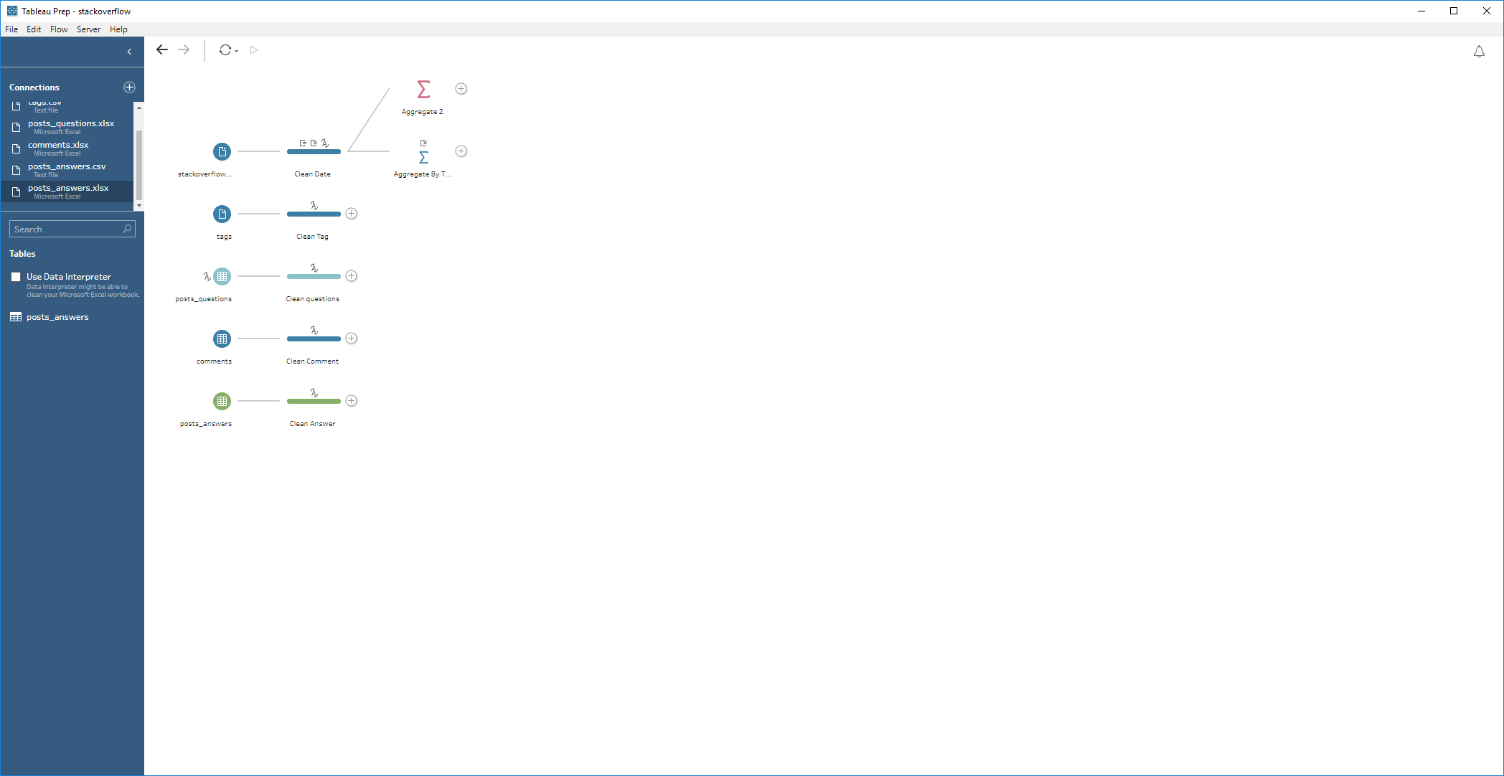
According to Stackoverflow Dataset, we can use BigQuery API to get data. Stackoverflow's data is bigdata, we might not be able to process all data, so limit is provided to limit rows will be fetched. read_stackoverlow.py will read data into a folder by given limit.
* Import data to Tableau Prep, change all date time type and remove most of null value * Convert id as string * Split tags into multiple keywords * Group posts by different keywords

